Slide 1

Deep Learning Model Evaluation: A Comparative Study
This presentation examines the performance of deep learning models across different datasets and tasks, showcasing the strengths and limitations of Artificial Neural Networks (ANNs) and Convolutional Neural Networks (CNNs).
ABDUL HASEEB CHAUDHARY (SP23-BAI-001)
HAMZA AHMAD (SP23-BAI-018)
SYED AHMAD ALI (SP23-BAI-050)

Slide 2
MNIST Dataset: Handwritten Digit Recognition
Dataset Description
PyTorch ANN Model
The MNIST dataset comprises grayscale images of handwritten digits from 0 to 9, each image consisting of 784 pixels (28x28). The dataset includes 60,000 training samples and 10,000 testing samples, commonly used for evaluating classification models.
A PyTorch ANN was designed for classifying MNIST digits. The model consists of an input layer with 784 nodes, followed by five hidden layers with sizes 200, 170, 140, 90, and 50 neurons respectively, each using the ReLU activation function. The final output layer consists of 10 nodes representing the 10-digit classes. The weights of the layers are initialized using Xavier Normal Initialization to ensure proper scaling of gradients. The model was trained using the SGD optimizer and CrossEntropyLoss, which includes the application of the softmax function internally during the loss computation.

Slide 3
California Housing Dataset: Median House Value Prediction
Dataset Description
PyTorch ANN Model
The California Housing dataset contains numerical features related to housing metrics, including population, median income, and latitude/longitude, for various California districts. The dataset consists of 20,000 samples split into 80% training and 20% testing.
A PyTorch ANN was implemented for predicting the median house value in a district. The model consists of 8 input nodes corresponding to the features, followed by a hidden layer with 16 neurons using the ReLU activation function and an output layer with one node for continuous value prediction (no activation). The model's weights were initialized with random normal initialization. The training process was carried out using the SGD optimizer and the Mean Squared Error (MSE) loss function.

Slide 4
ASL Dataset: Image Classification
Dataset Description
Keras CNN Model
The CIFAR-10 dataset consists of 32x32 pixel color images belonging to 10 distinct object categories, with 50,000 training samples and 10,000 testing samples. This dataset is ideal for evaluating image classification models, especially those involving spatial feature extraction.
A Keras CNN model was built for classifying images in the ASL dataset. The model includes two convolutional layers with 32 and 64 filters (3x3 kernel size, ReLU activation), each followed by max pooling. A fully connected layer with 128 neurons (ReLU activation) precedes the output layer with 10 nodes (Softmax activation). The Adam optimizer and categorical crossentropy loss were used for training.

Slide 5
Comparative Table
Model | Dataset / Task | Key Hyperparams | Final Metric | Training Time
PyTorch ANN (Reg) | California Housing | LR=0.01, batch_size = 64, Epoch=100 | MSE = 0.39, MAE = 0.44, R² = 0.70 | ~0.5 min
PyTorch ANN (Class) | MNIST | LR=0.01, Epoch=20, Batch Size = 50 | Accuracy = 97.17% | ~1 Min
Keras CNN (Class) | ASL | LR=0.0001, Epoch=20 | Accuracy = 88.7% | ~8 min

Slide 6
Performance Analysis: Metrics and Visualizations
MNIST PyTorch ANN
California Housing PyTorch ANN
ASL Keras CNN
The PyTorch ANN achieved an accuracy of 97.17% on the MNIST dataset, demonstrating its effectiveness in recognizing handwritten digits. This model was trained for 20 epochs with a learning rate of 0.01 and a batch size of 620.
The Keras CNN model achieved an accuracy of 88.7% on the CIFAR-10 dataset, indicating its capability in image classification. Training was performed for 25 epochs with a learning rate of 0.001 and a batch size of 32. The confusion matrix reveals that the model experiences moderate confusion between similar categories, such as cats and dogs, suggesting areas for further improvement.
The PyTorch ANN achieved a Mean Squared Error (MSE) of 0.39 and a Mean Absolute Error (MAE) of 0.44 on the California Housing dataset. This indicates that the model can predict median house values with reasonable accuracy, considering the complexity of the task. The model was trained for 100 epochs with a learning rate of 0.01 and a batch size of 64.

Slide 7
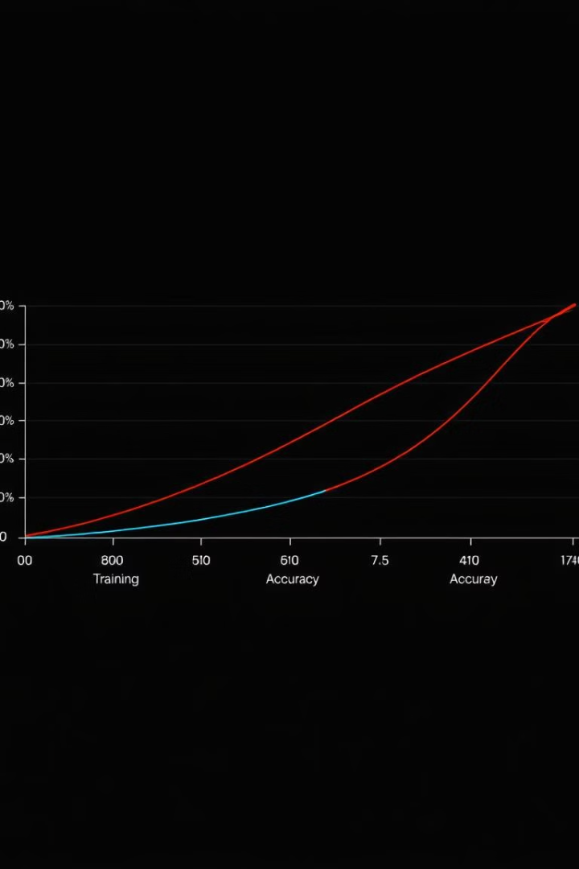
Learning Curves: Model Training Progress
1
The learning curves for the PyTorch ANN on MNIST show a steep learning rate in the initial epochs, followed by stabilization as the model reaches convergence. This behavior indicates efficient learning and a well-tuned model.
2
The learning curves for the Keras CNN on ASL exhibit a gradual improvement in validation accuracy throughout the training process, indicating that the model is learning effectively without overfitting. The slower convergence compared to MNIST is likely due to the higher complexity of the image classification task.

Slide 8
Model Comparison: Strengths and Weaknesses
Strengths
Weaknesses
The PyTorch ANN exhibits flexibility for experimentation and achieved high accuracy on the simpler MNIST dataset. Keras CNN, on the other hand, offers a user-friendly and efficient approach, particularly suitable for image-based data like ASL
The PyTorch ANN might be less suitable for complex image data due to its lack of feature extraction layers. While the Keras CNN performs well, it generally demands more computational resources compared to a simple ANN.

Slide 9
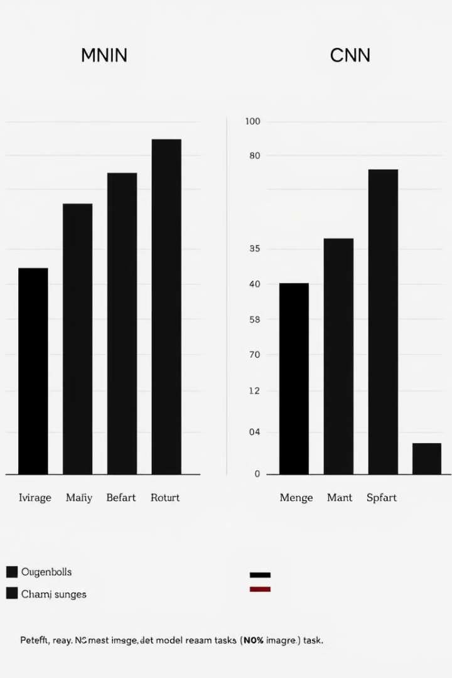
Notable Findings: Model Suitability
1
Simplicity vs. Complexity
2
Spatial Feature Extraction
Artificial Neural Networks (ANNs) are well-suited for simpler tasks, such as handwritten digit recognition (MNIST), but they may struggle with more complex tasks involving spatial feature extraction.
Convolutional Neural Networks (CNNs) excel in tasks requiring spatial feature extraction, such as image classification (ASL). Their inherent architecture allows them to learn and exploit spatial patterns within data.

Slide 10

Conclusion: Key Takeaways and Next Steps
This comparative analysis reveals that both ANNs and CNNs are valuable tools in deep learning, each with its strengths and weaknesses. ANNs offer flexibility and effectiveness for simpler tasks, while CNNs excel in image-based tasks requiring spatial feature extraction. Further research is needed to explore hybrid architectures that leverage the strengths of both approaches. Moreover, investigating the performance of these models on more challenging datasets, such as ImageNet, would provide a comprehensive understanding of their capabilities and limitations.

